Slide 1
George Washington Bridge
By abhay

Slide 2
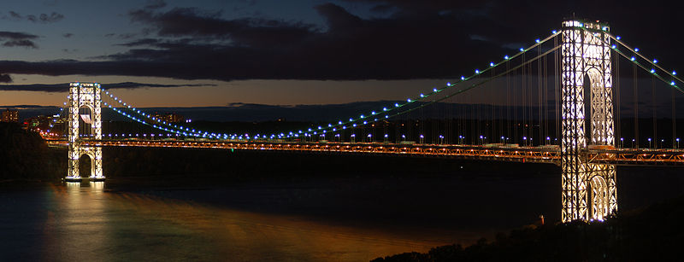
4,700 feet between each support
The bridge cost 59 million dollars
The builder is Amanda
George Washington Bridge

Slide 3
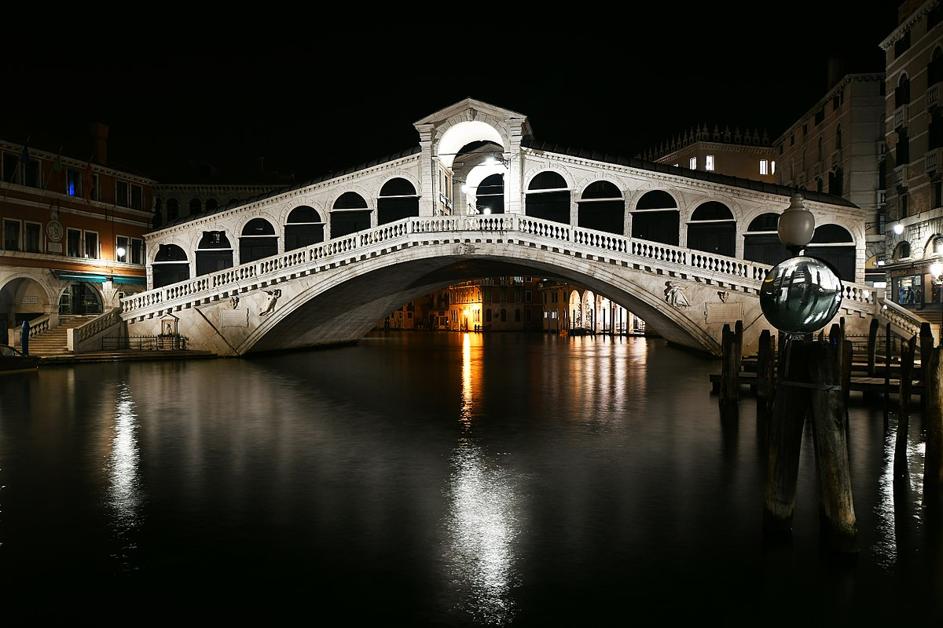
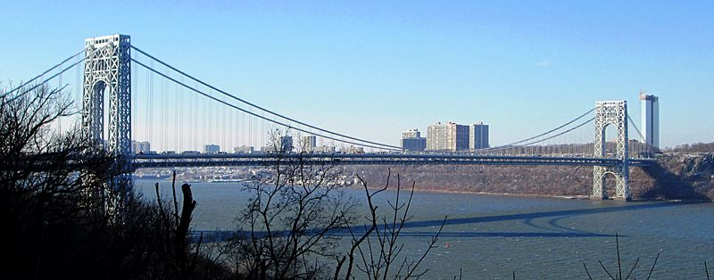
The George Washington Bridge is
2,121 meters
longer then the bridge of Rialto
George Washington Bridge, New York City
Rialto Bridge, Venice Italy
2,196 Meters long
75meters long

Slide 4
Researched and
Produced by
Abhay from 3rd grade at Buck Lake
Tallahassee, Florida

